Slide 1
Mod 5: Special semiconductor devices

Slide 2
Varactor diode:
It is denoted by V_{D}
linear graded diode
CT IS propotional to V^{-n}
where n=1/3 for V_{D}
Principle transition capacitance
always operated under RB.
C_{T} proportional to 1/³√RB
Used material GaAs

Slide 3
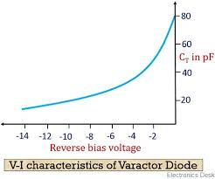
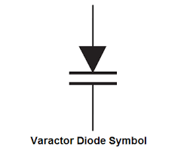

Slide 4
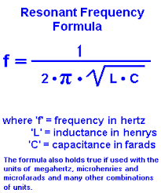
Another name of Varactor Diode
Vari-cap diode
Volta -cap diode
epi-cap diode
Control frequency

Slide 5
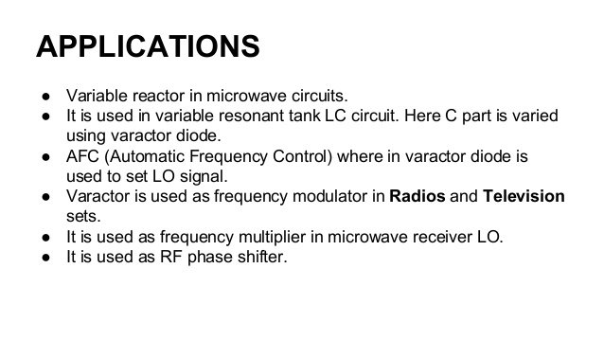

Slide 6
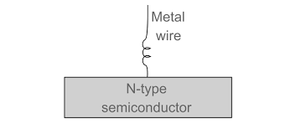
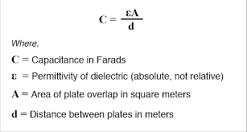
Point contact DIODE
It is oldest diode
metal semiconductor diode
Tungstun metal in the form of CAT whisker is attached to the semiconductor material forming a jn.
smallest value of jn capacitance

Slide 7
Photonic DEVICES
LED
LASER
PHOTO DETECTOR
SOLAR CELLS

Slide 8
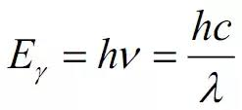
LED: Light emitting diode
LED, is light-emitting diode, a semiconductor device that emits infrared or visible light when charged with an electric current.
Visible LEDs are used in many electronic devices as indicator lamps, in automobiles as rear-window and brake lights, and on billboards and signs as alphanumeric displays or even full-colour posters
LEDs operate by electroluminescence, a phenomenon in which the emission of photons is caused by electronic excitation of a material.

Slide 9
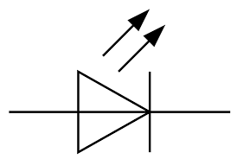
LED Symbol
The material used most often in LEDs is gallium arsenide
By varying the precise composition of the semiconductor, the wavelength (and therefore the colour) of the emitted light can be changed.
LED emission is generally in the visible part of the spectrum (i.e., with wavelengths from 0.4 to 0.7 micrometre) or in the near infrared (with wavelengths between 0.7 and 2.0 micrometres).
The applied voltage in most LEDs is quite low, in the region of 2.0 volts

Slide 10
LASER:Light amplification by stimulated emmission of radiation
A laser is a device that emits a beam of coherent light through an optical amplification process
Lasers are distinguished from other light sources by their coherence.
DBGSC USED
PROPERTY
Directionality
Spontaneus emission
stimulated emission
Used in optocouplers and microwave application

Slide 11
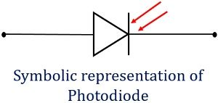
Photo detector or Photo diode
A special type of PN junction device that generates current when exposed to light is known as Photodiode. It is also known as photodetector or photosensor. It operates in reverse biased mode and converts light energy into electrical energy.
Principle of Photodiode
It works on the principle of Photoelectric effect.
The operating principle of the photodiode is such that when the junction of this two-terminal semiconductor device is illuminated then the electric current starts flowing through it. Only minority current flows through the device when the certain reverse potential is applied to it.

Slide 12
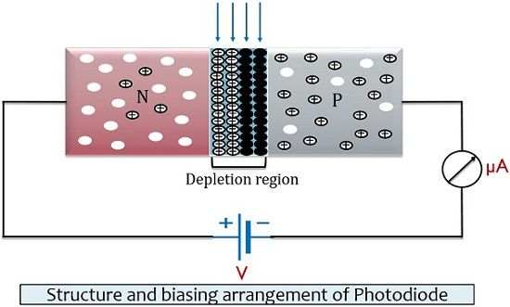
Working of Photodiode
In the photodiode, a very small reverse current flows through the device that is termed as dark current. It is called so because this current is totally the result of the flow of minority carriers and is thus flows when the device is not exposed to radiation

Slide 13
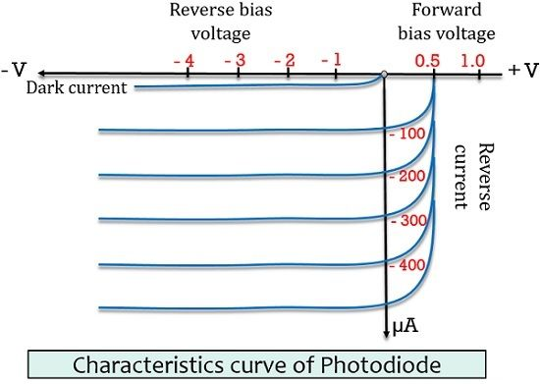
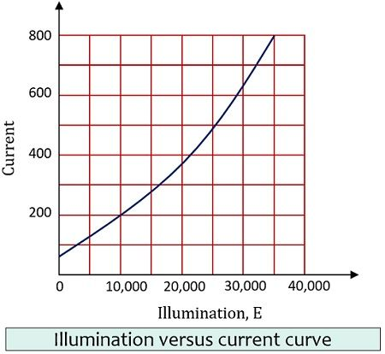
CHARACTERISTICS OF PHOTODIODE

Slide 14
Advantages of Photodiode
It shows a quick response when exposed to light.
Photodiode offers high operational speed.
It provides a linear response.
It is a low-cost device.
Disadvantages of Photodiode
It is a temperature-dependent device. And shows poor temperature stability.
When low illumination is provided, then amplification is necessary.

Slide 15
Applications of Photodiode
Photodiodes majorly find its use in counters and switching circuits.
Photodiodes are extensively used in an optical communication system.
Logic circuits and encoders also make use of photodiode.
It is widely used in burglar alarm systems. In such alarm systems, until exposure to radiation is not interrupted, the current flows. As the light energy fails to fall on the device, it sounds the alarm.

Slide 16
Solar Cell
A solar cell (also known as a photovoltaic cell or PV cell) is defined as an electrical device that converts light energy into electrical energy through the photovoltaic effect. A solar cell is basically a p-n junction diode. Solar cells are a form of photoelectric cell, defined as a device whose electrical characteristics – such as current, voltage, or resistance – vary when exposed to light

Slide 17
Materials Used in Solar Cell
The materials which are used for this purpose must have band gap close to 1.5ev. Commonly used materials are-
Silicon.
GaAs.
CdTe.
CuInSe2

Slide 18
Advantages of Solar Cell
No pollution associated with it.
It must last for a long time.
No maintenance cost.
Disadvantages of Solar Cell
It has high cost of installation.
It has low efficiency.
During cloudy day, the energy cannot be produced and also at night we will not get solar energy.

Slide 19
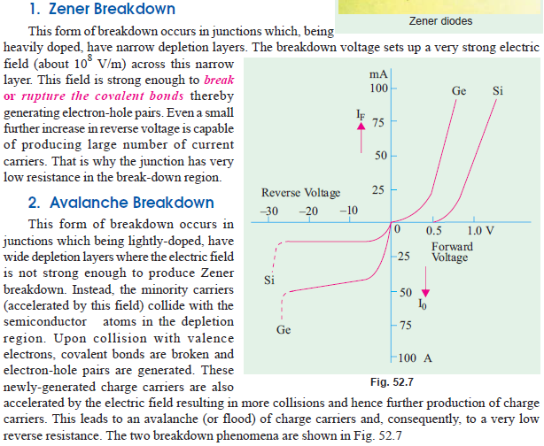
Avalanche and Zener Breakdown

Slide 20
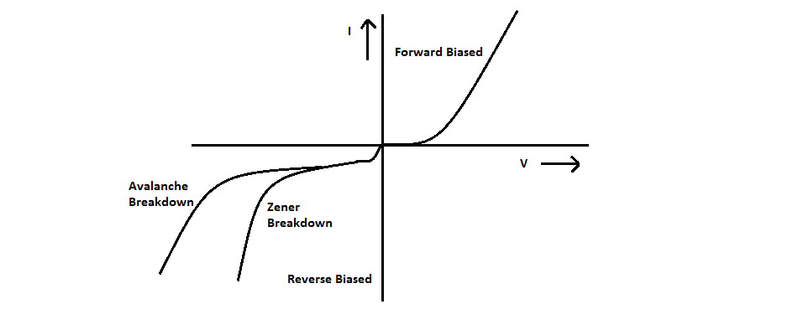
VI Characteristics

Slide 21
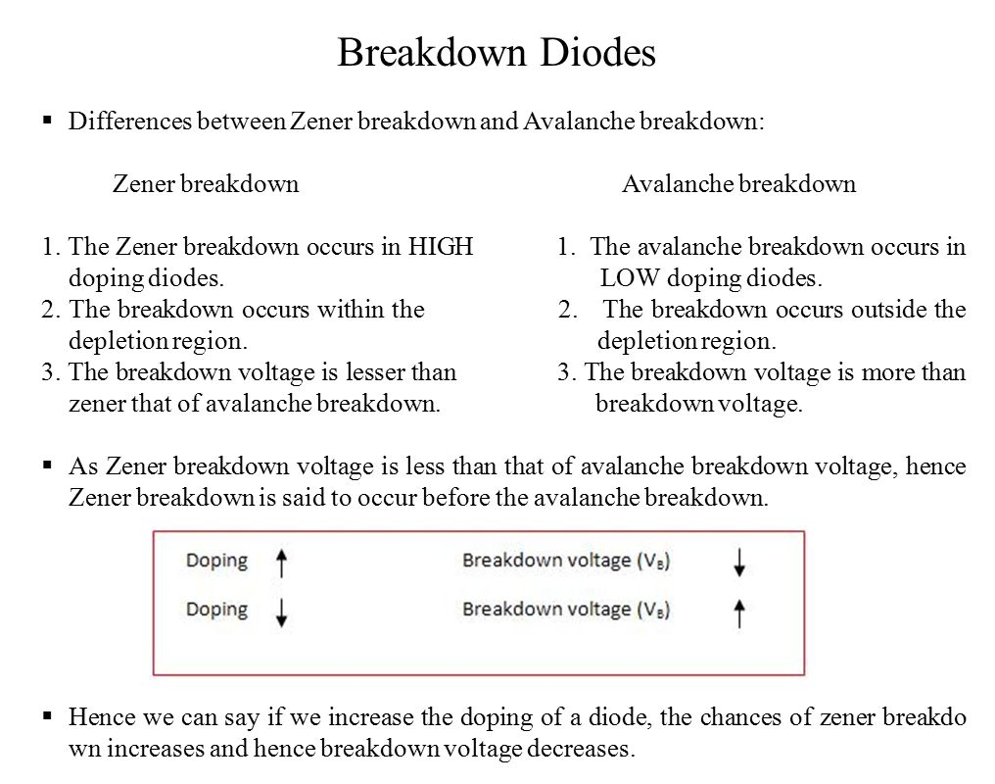

Slide 22
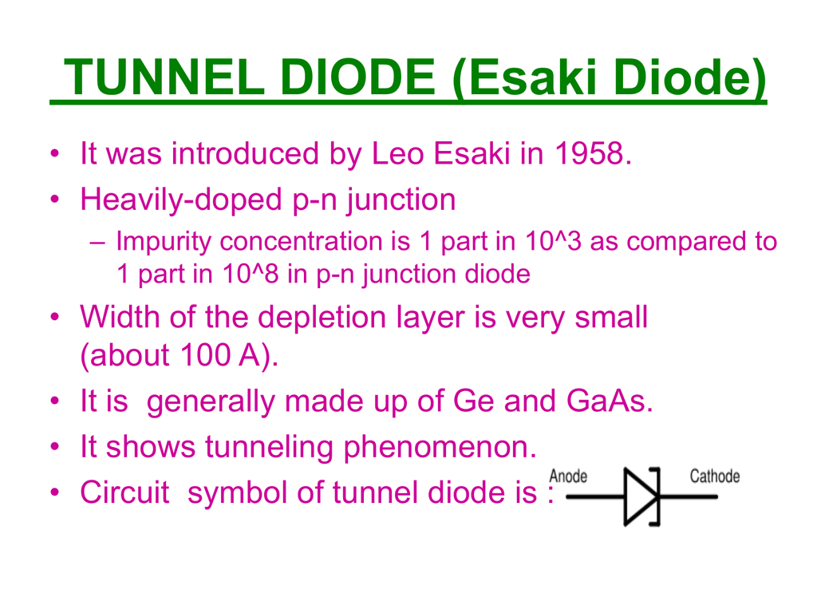

Slide 23
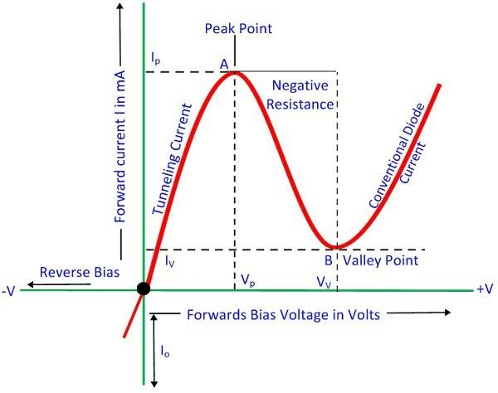
VI CHARACTERISTICS

Slide 24
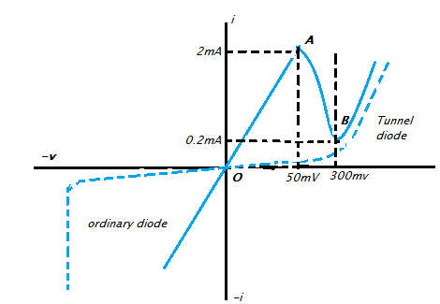
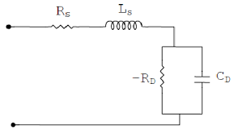
Equaivalent ckt

Slide 25
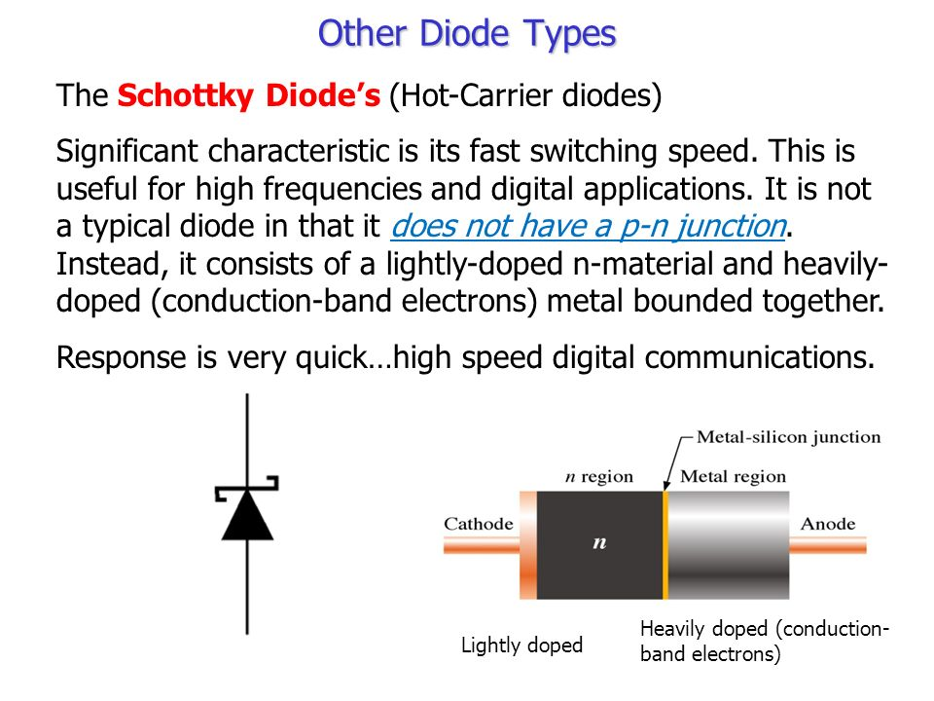

Slide 26
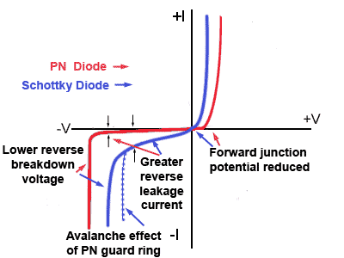
VI Characteristics

